Slide 1
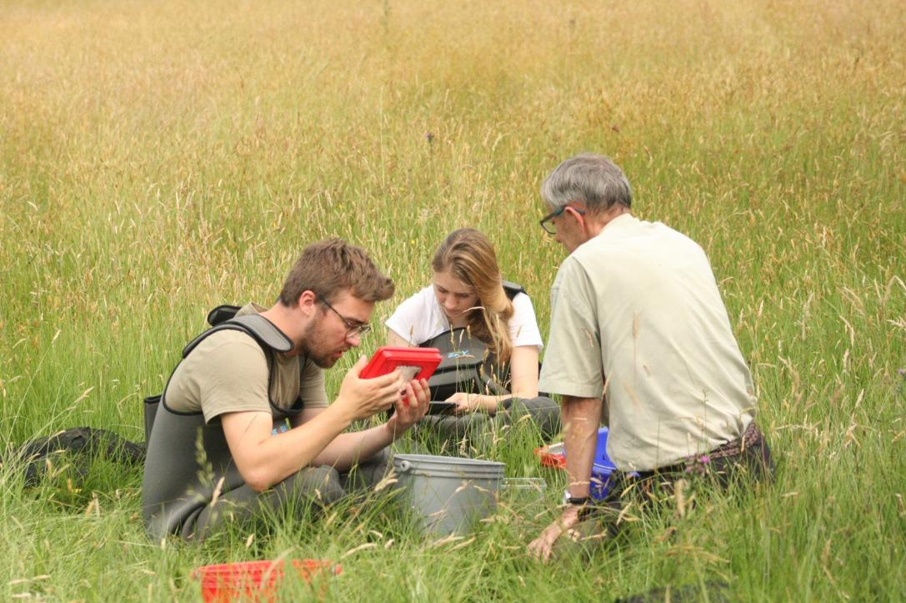
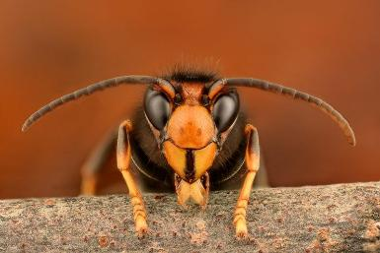

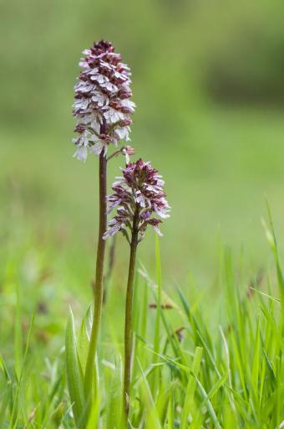
Using citizen science to monitor protected and invasive alien species in Flanders
Stijn Van Onsem - Coordinator biotic monitoring
Jasmijn Hillaert – Researcher Vespa-Watch
© Gilles San Martin

Slide 2
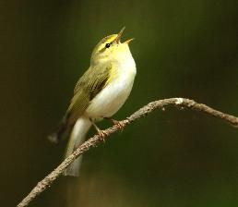
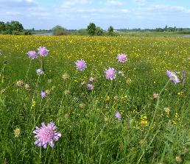
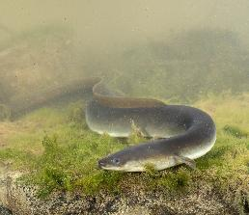
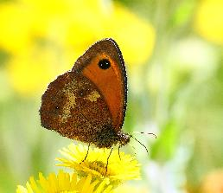
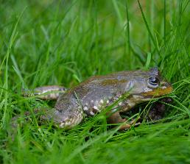
EU Nature legislation
→ Reporting obligations for species trends
Habitats Directive
1992
Birds Directive
1979
Nature Restoration Regulation
2024
Water Framework Directive
2000
Invasive Alien Species Regulation
2014

Slide 3
EU Nature legislation
→ Reporting obligations for species trends
Habitats Directive
1992
Birds Directive
1979
Nature Restoration Regulation
2024
Water Framework Directive
2000
Invasive Alien Species Regulation
2014
Notes:
Article 20 - monitoring

Slide 4
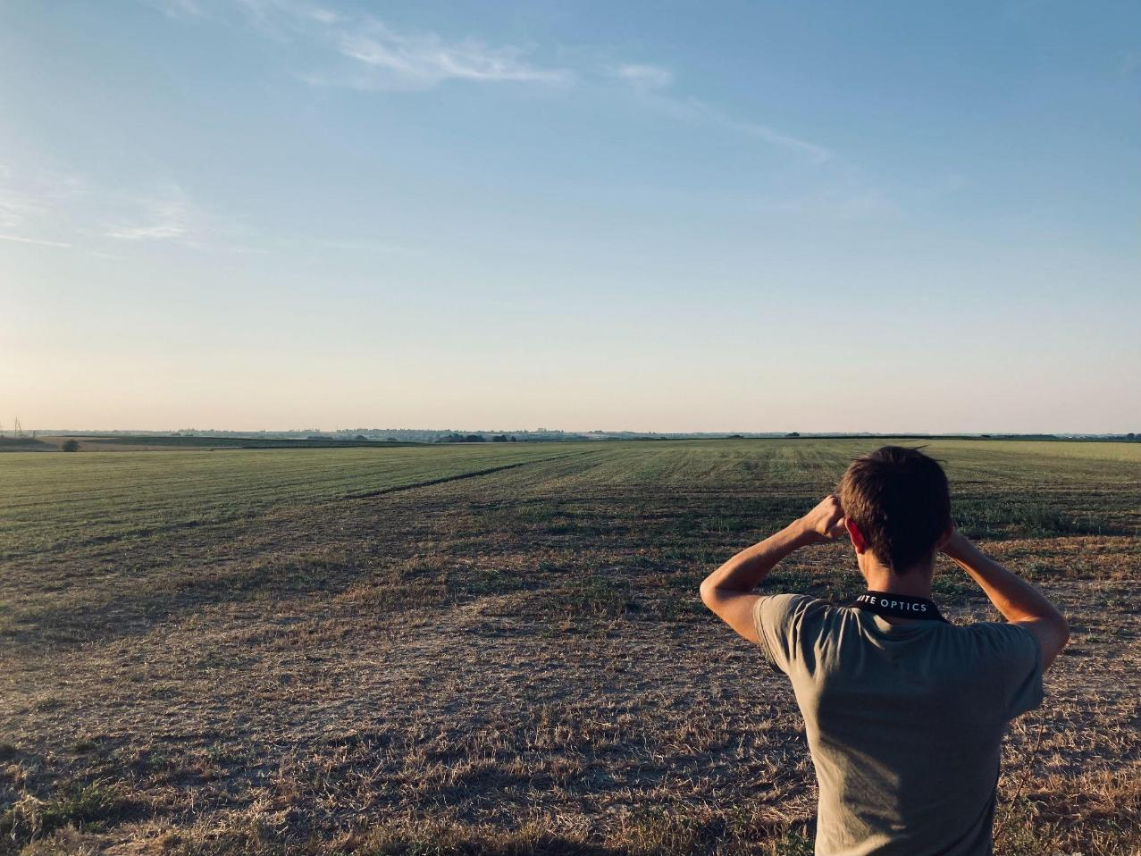
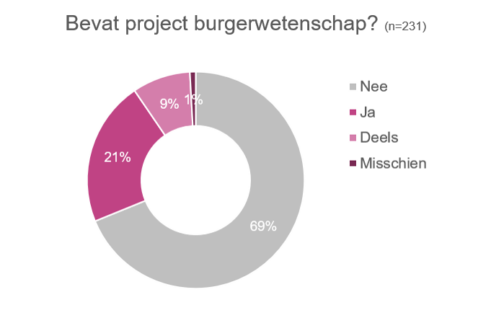
CITIZEN SCIENCE @ INBO

Slide 5
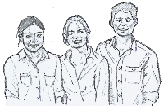
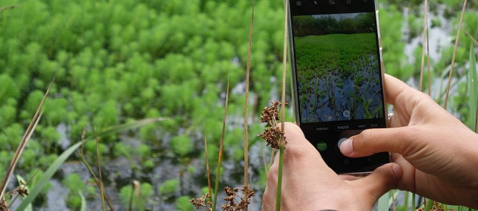
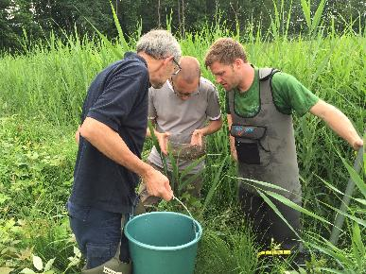
Types of citizen science data
Opportunistic observations
  Waarnemingen.be, ObsIdentify, iNaturalist,…
  Unstructured big data
Standardized monitoring networks
  Specific monitoring protocol for structured data collection
“OPPORTUNISTIC”
“STANDARDIZED”
Life RIPARIAS
Hannes Ledegen

Slide 6
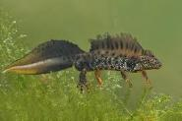
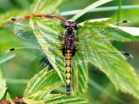
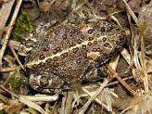
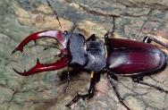
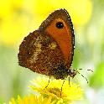
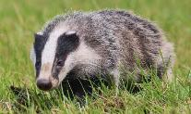
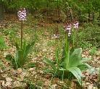
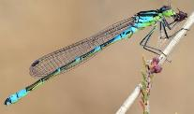
Protected & threatened species
Some of the European priority species:
Crested Newt
(Triturus cristatus)
Yellow-spotted Whiteface
(Leucorrhinia pectoralis)
European priority species (EPS) n=134
  Habitats Directive Annex II, IV or V
  Birds Directive Annex I
  Ramsar convention Overwintering waterbirds
  Eel regulation
  …
Flemish priority species (FPS) n=60
  Criteria
  Relative importance of Flanders
  Red list status
  Bio-indicators for good habitat quality
  Species Protection Programme
  …
Natterjack Toad
(Epidalea calamita)
Stag Beetle
(Lucanus cervus)
Some of the Flemish priority species:
Gatekeeper
(Pyronia tithonus)
Badger
(Meles meles)
Lady orchid
(Orchis purpurea)
Irish damselfly
(Coenagrion lunulatum)
Notes:
For monitoring of (mainly terrestrial) species, we make a distinction between European and Flemish priority species -----
in addition we defined a number of Flemish priority species → conservation needs, scientific basis

Slide 7
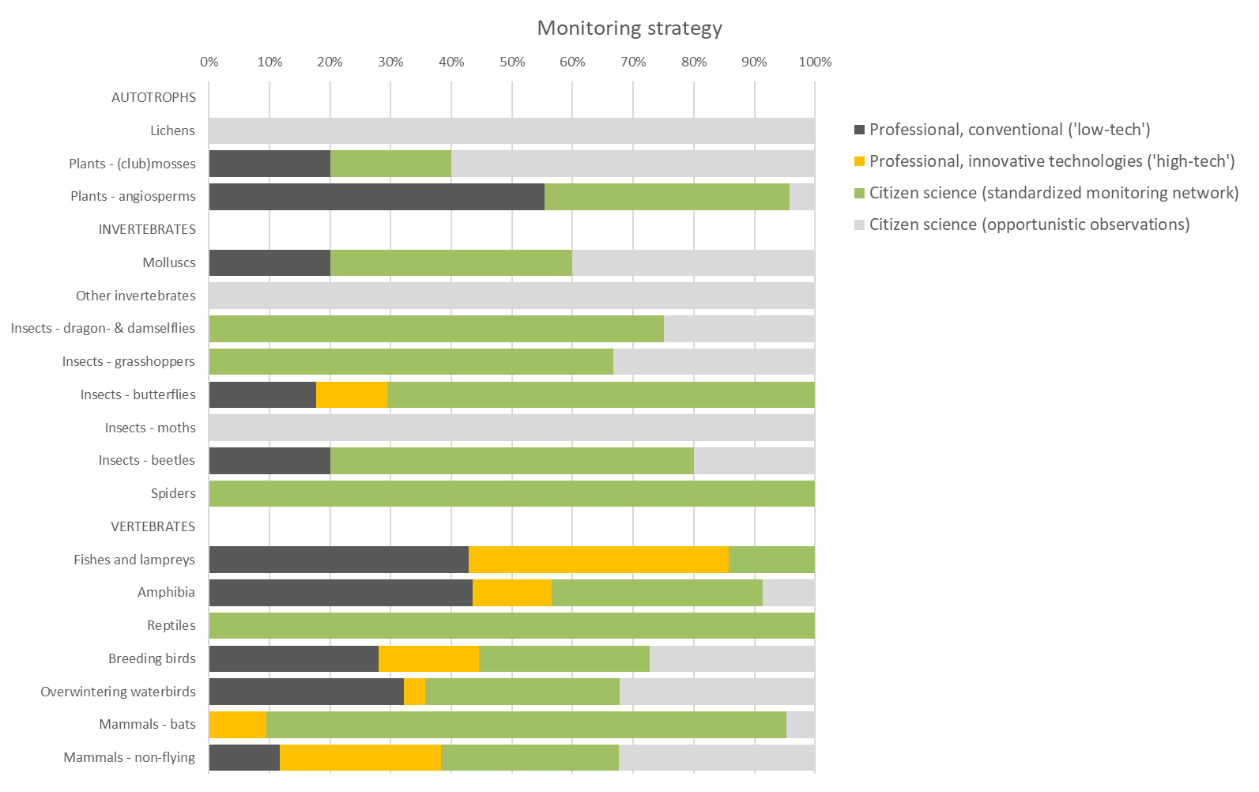
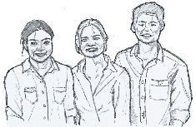
Data acquisition mode
Strong reliance on citizen science for some taxonomic groups
Notes:
Structured monitoring

Slide 8
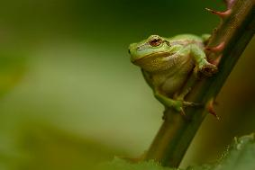
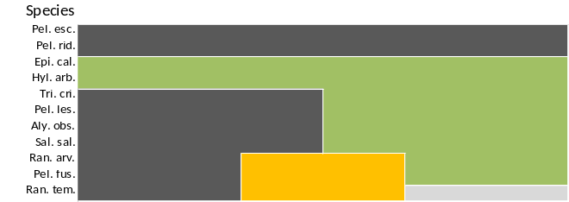
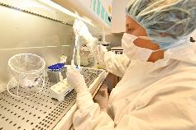
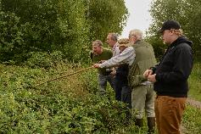
Data acquisition mode
Amphibia
eDNA
DNA barcoding
Standardized citizen science monitoring schemes
Notes:
For other groups: more mixed professional and citizen science

Slide 9
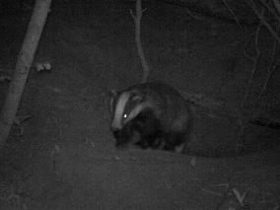
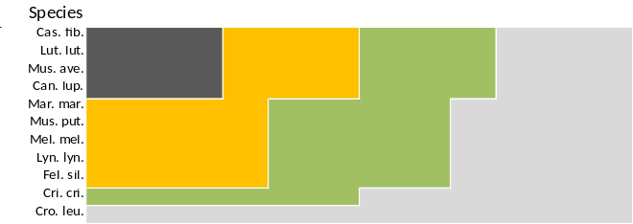
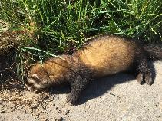
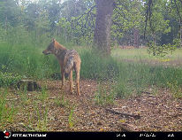
Data acquisition mode
Mammals (excl. bats)
Citizen science (opportunistic data)
Camera traps
Population genetics
eDNA

Slide 10


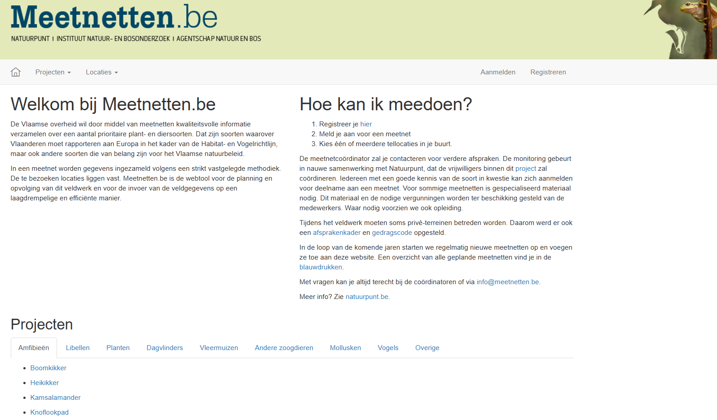

Slide 11

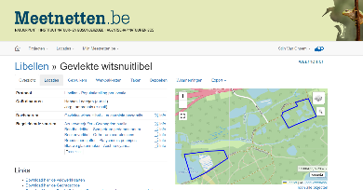










Standardized citizen science project
“Species monitoring schemes”
Since 2016 | public tender | 5-year cycles | 94 monitoring schemes
Organisation & governance
FINANCING
COORDINATION
€
€
€
VOLUNTEER COORDINATION
DATA PORTAL
external contractor
FIELD VISITS
DATA COLLECTION
individual volunteers + working groups + contractor
volunteers
working groups
DATA ANALYSIS
REPORTING
Notes:
Public procurement
Contractor hosts data portal with protocols, personal tasks, observations,…
Non-profit organisations

Slide 12
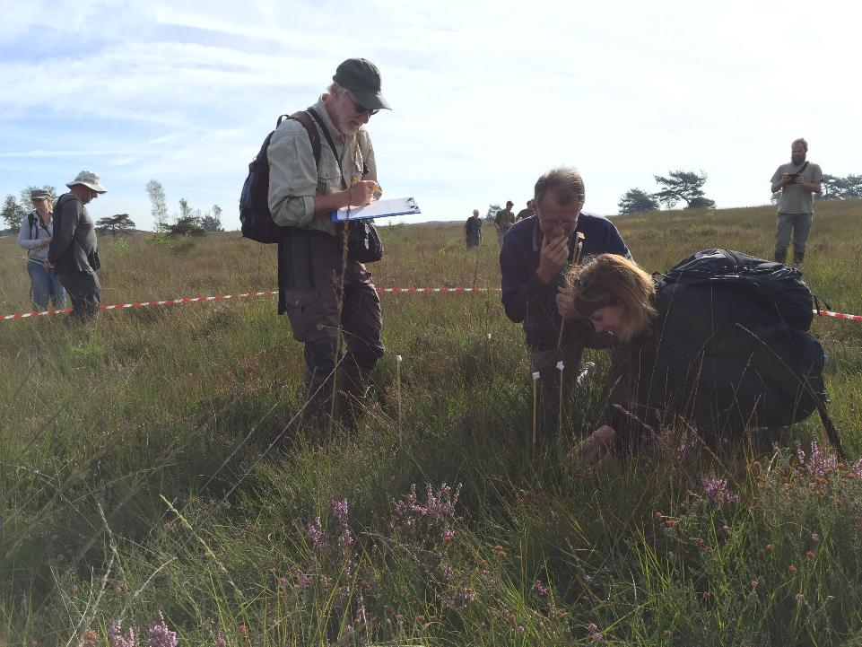

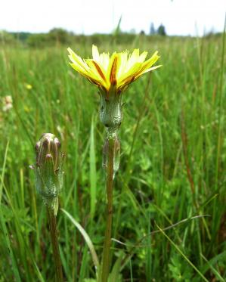
Scorzonera humilis
© Jan Van Uytvanck

Slide 13
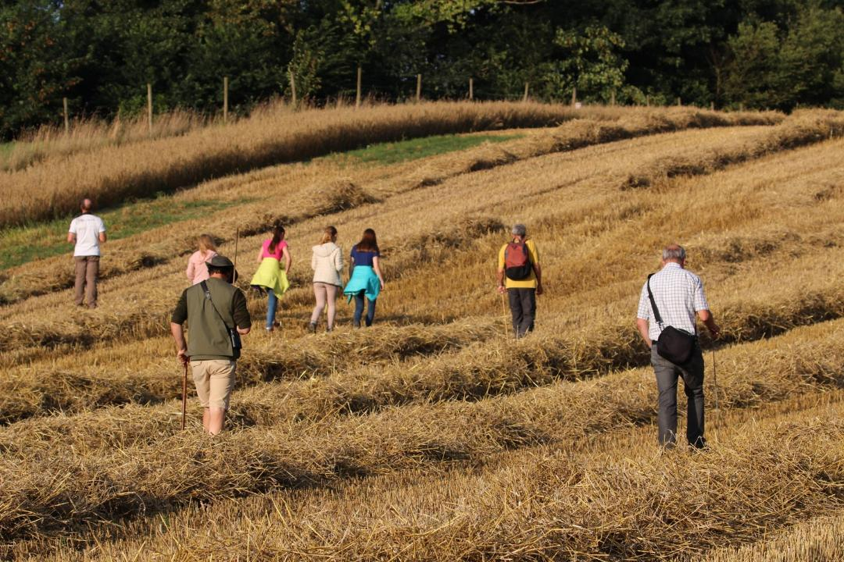
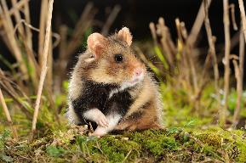
© Vilda/Rollin Verlinde)
© Jos Reekmans
Notes:
We rely on citizen scientists
One of our larger monitoring programmes is a citizen science project, collaboration between INBO, ANB and Natuurpunt (largest non-profit nature organisation in Flanders)
Volunteers screening for presence of hamster nests

Slide 14
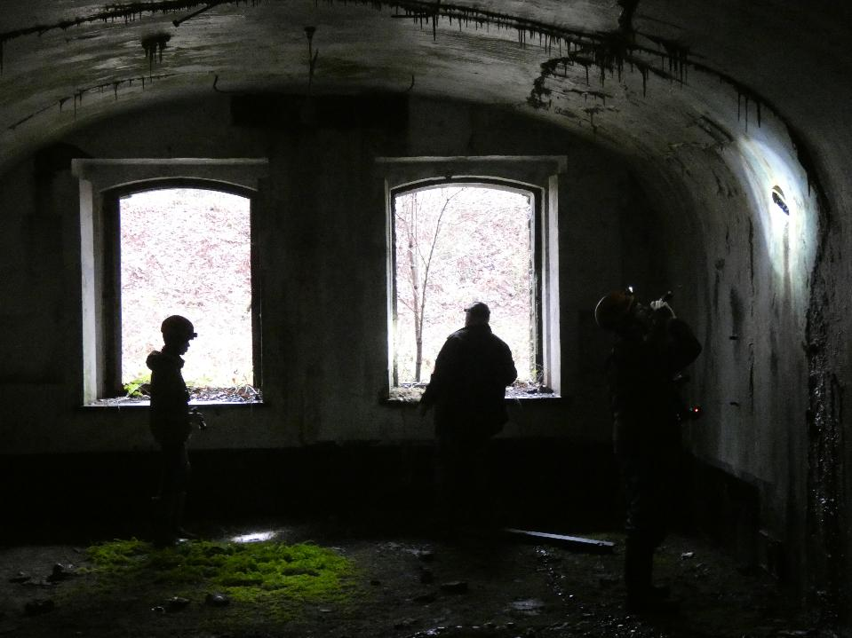


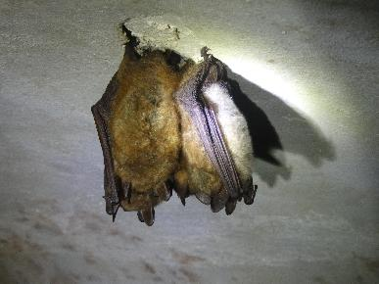
Bat monitoring by volunteers
Habitats Directive
Notes:
Forts and caves where bats hibernate

Slide 15

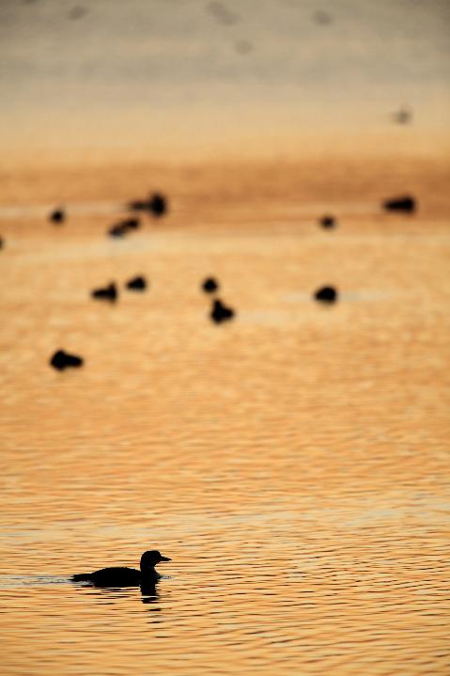


Bird monitoring by citizen scientists
Common, scarce and rare breeding birds (ABV – SBV – BBV)
Bird Atlas Flanders (2020-2024) vogelatlas.be
Wintering Waterbird Counts (since 1967)
PTT / Point-Transect Counts for wintering birds (since 1989)
MBAG-MAS / Monitoring Agricultural Species
MBAG-MAS
Notes:
Other major bird monitoring programmes
MBAG: In that sense, it’s good to know that we developed and tested a set of standardized monitoring schemes for agricultural biodiversity

Slide 16

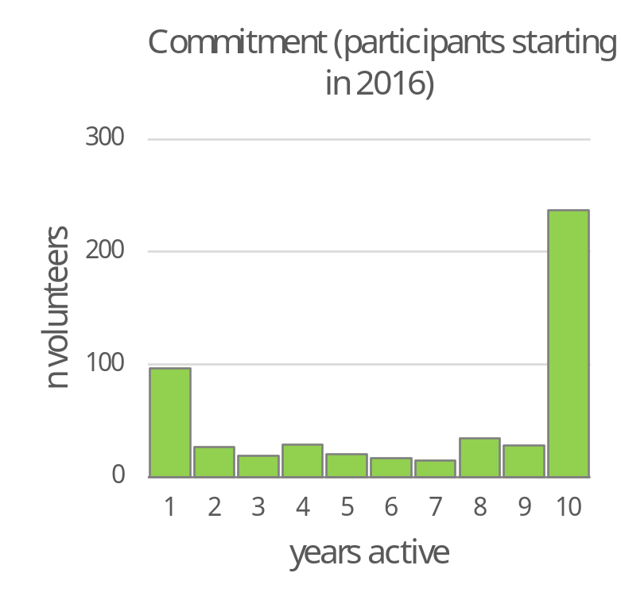
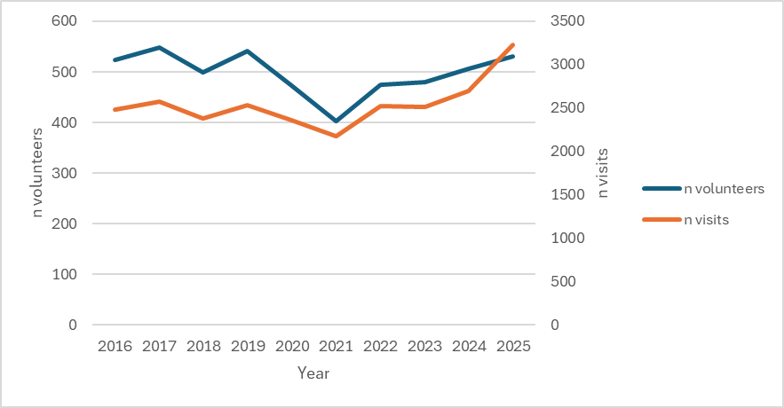
Experience with ‘species monitoring schemes’ project
Relatively stable pool of volunteers
High commitment
High success rate: >95% of all goals (terrain visits) reached
High commitment
Notes:
Illustrated by the fact that 10 years after the start of the project, many volunteers are still active

Slide 17
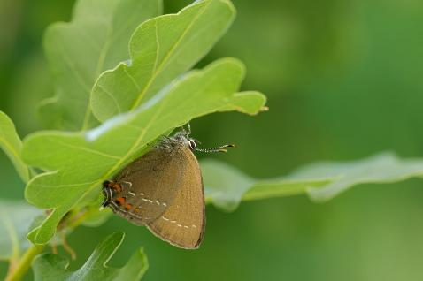
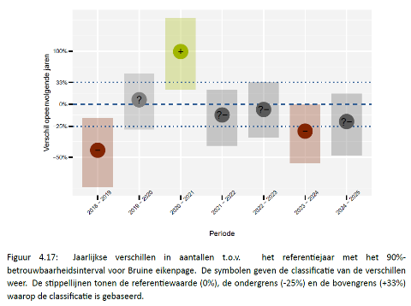
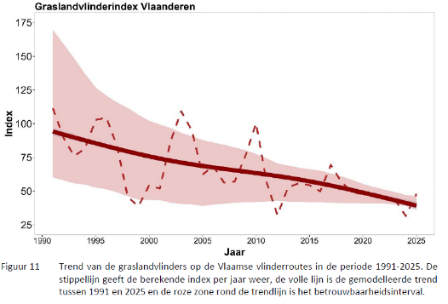
Structured monitoring allows to identify overall trends on a regional scale
For
individual species and ecological guilds
ilex hairstreak / bruine eikenpage (Vilda / Lars Soerink)
Grassland butterflies index Flanders
Westra, T., et al. (2026). Trends op basis van de dagvlindermeetnetten (2016 - 2025): Citizen science monitoring in Vlaanderen. INBO
Maes, D. & Piesschaert, F. (2026). Dagvlindermonitoring in Vlaanderen 2025. INBO
Notes:
We learn from citizen science that grassland butterflies are not doing well

Slide 18



Invasive Alien Species
© Gilles San Martin

Slide 19
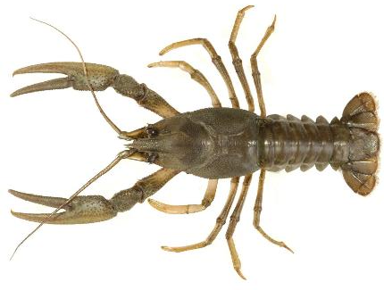
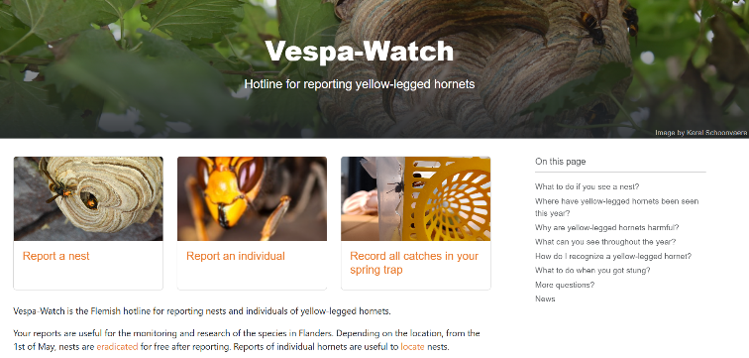
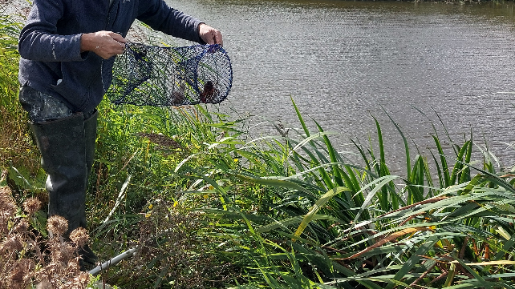
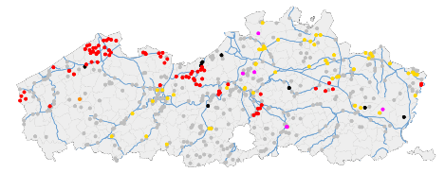
Invasive Alien Species
Citizen science projects
  Vespawatch.be
  Craywatch.inbo.be
  Flatwormwatch
  …
Bram Koese/EIS
Invasive crayfish Craywatch.inbo.be
Notes:
Surveyed / Determine the distribution of invasive alien crayfish

Slide 20
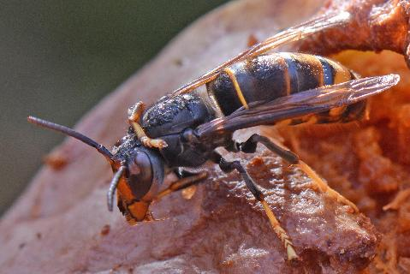

Vespa-Watch
Yellow-legged hornet – Aziatisch hoornaar (Vespa velutina)
Started in 2018 as a collaboration between INBO and Honeybee Valley,
Supported by WEWIS & Scivil
Websites
https://www.vespawatch.be/
https://app.vespawatch.be/
Notes:
Departement Economie, Wetenschap en Innovatie (EWI).

Slide 21







Reporting of primary and secondary nests on vespawatch.be
rato vzw
Source: Karel Schoonvaere et al. (2017)
Notes:
Nestopsporing en nestverdelging zijn afgestemd op levenscyclus. Voorjaar: kleine nesten zoeken in schuurtjes, etc. Ditchtbtij de grond. Deze worden vaak handmatig verwijderd in het donker (wnn koningin in het nest is). Primaire nesten groter maar op dezelfde plaats (handmatig of met biocide, afhankelijk van grote). Secundaire nesten: vaak hoog in boom (net onder de kruin), verwijderd met telescoopstok waarlangs biocide onder druk via pin in het nest wordt gespoten.

Slide 22



Monitoring the invasion of Vespa velutina by citizens
www.vlaanderen.be/inbo
Notes:
filmpje van de gemodelleerde invasie

Slide 23

Management scenarios
What is the effect of management intensity?
What is the effect of management at different spatial scales? (e.g. at the level of Flanders, a province or municipality)
What is the effect of spring trapping?
© INBO

Slide 24
Relevance of citizen science in Flanders
Citizen science is cornerstone of biodiversity monitoring
  Integration in Nature Restoration Regulation monitoring (together with innovative technologies like animal sensor networks)
Frequent use in monitoring of Invasive Alien Species (e.g. Vespawatch.be, Craywatch.inbo.be)
Large, stable pool of motivated citizen scientists
Challenges remain in terms of sustainability for some monitoring schemes (overdependence on a few very active participants)
  Promote intensive communication & sense of ownership

Slide 25




Acknowledgements
Thank you for your attention!
Natuurpunt Studie
Hannes Ledegen
Sam Van De Poel
INBO
Tim Adriaens
Kristof Baert
Bram D’Hondt
Dries Bonte
Jim Casaer
Joris Everaert
Frank Huysentruyt
Johannes Jansen
Dirk Maes
Rhea Maesele
Kurt Schamp
Jeroen Speybroeck
Eric Stienen
Diederik Strubbe
Loïc van Doorn
Charlotte Van Driessche
Heleen Van Ransbeeck
Pieterjan Verhelst
Glenn Vermeersch
Toon Westra
INBO @ ECS platform: https://www.citizenscience.eu/organisation/66

